Slide 1
Trauma and its Treatment (the psychiatric point of view) and the Evidence for GLP-1 Agonists in Addiction
Dr Fergus Law
Consultant Psychiatrist in Substance Misuse, PsychInsight
DrFergus.Law@PsychInsight.co.uk
British Doctors & Dentists Group annual convention on 27 Sept 2025

Slide 2
Outline
GLP-1 receptor agonists
Trauma
ACE’s
Attachment styles
Stress & trauma syndromes
Treatment for trauma, including Seeking Safety, IFS and EMDR

Slide 3
Glucagon-like Peptide-1 (GLP-1) Receptor Agonists

Slide 4
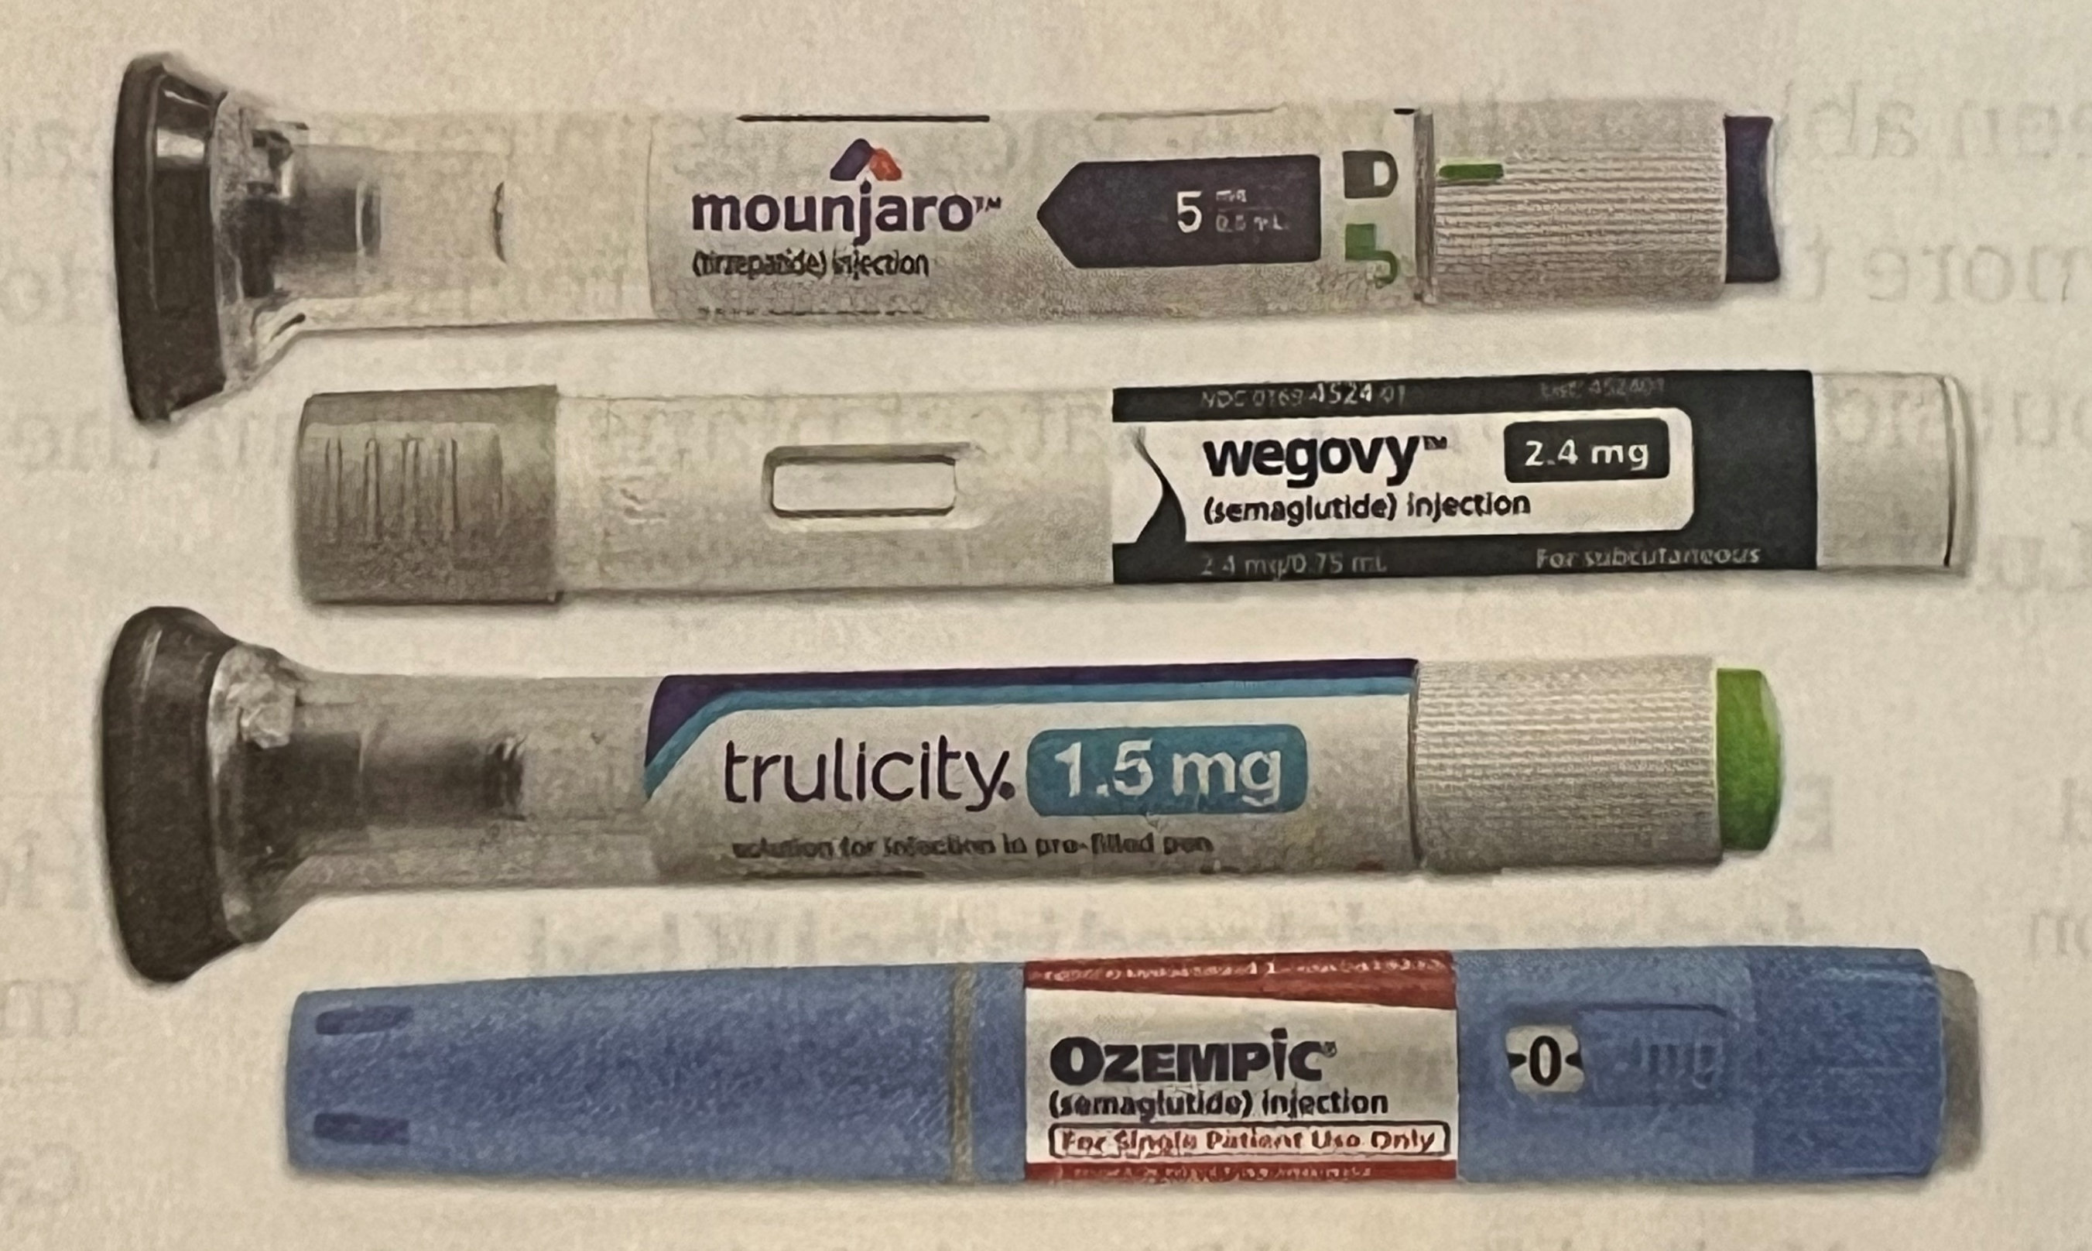
Image from ‘Side effects of GLP-1 receptor agonists’ (editorial), Manne-Goehler and Franco. BMJ 2025;390:r1606 on p. 125 print version

Slide 5
Mechanism of Action of GLP-1 Receptor Agonists
Activates the GLP-1 receptor, mimicking the endogenous incretin hormone GLP-1, which is released by the gut after eating
Slows gastric emptying, increases satiety
Reduces food intake and therefore body weight, so can be used to treat obesity
Inhibits the release of glucagon
Stimulates insulin production and therefore reduces blood glucose (and HbA1c levels)

Slide 6
Endogenous GLP-1 Agonists in Humans
Production in the gut:
Gut hormone produced by cleavage of the prohormone proglucagon in intestinal endocrine L cells
Released in response to food intake
Half-life 1-2 minutes, inactivated by dipeptidyl peptidase 4 (DPP-4)
Production in the central nervous system:
Neurotransmitter produced in the nucleus tractus solitarius (NTS)

Slide 7
Only Two Indications for GLP-1 Receptor Agonists in the BNF
Type 2 diabetes: If existing treatment doesn’t achieve adequate glycaemic control, especially with atherosclerotic cardiovascular disease or obesity
Obesity: BMI ≥ 30 in the absence of diabetes, to be used in conjunction with diet and exercise, or BMI ≥ 27 if at least one weight related comorbidity
In development for other indications:
Non-alcoholic fatty liver disease
Polycystic ovary syndrome
‘Diseases of the reward system’, e.g. Substance use disorder, binge eating disorder
Notes:
SUB = Substance use disorder,
BED= binge eating disorder

Slide 8
Other Conditions where GLP-1 Receptor Agonists are Being Explored
Neuroprotection by stimulating differentiation of nerve cells and inhibiting neuro-inflammation
Protection against CVS disease and reducing cardiovascular mortality
Reducing BP
Animal research:
Reducing development & progression of tumours
Parkinson’s disease
Alzheimer’s disease
Dementia
Notes:
SUB = Substance use disorder,
BED= binge eating disorder

Slide 9
6 Drugs for Weekly or Daily Injection in the BNF licenced for DM type 2
Semaglutide weekly: Ozempic (& Rybelsus tabs)
Dulaglutide weekly: Trulicity
Tirzepatide weekly (dual GLP-1 and Gastric inhibitory polypeptide or GIP agonist): Mounjaro
Exenatide weekly or daily: Bydureon BCise
Liraglutide daily: generic, Victoza, Biolide, Diavic, Nevolat, Xegluxen
Lixisenatide daily: (no licenced medicines listed)
[Albiglutide, not mentioned in BNF]
Notes:
Gastric inhibitory polypeptide (GIP), also known as glucose-dependent insulinotropic polypeptide, is an inhibiting hormone of the secretin family of hormones. While it is a weak inhibitor of gastric acid secretion, its main role, being an incretin, is to stimulate insulin secretion. GIP, along with glucagon-like peptide-1 (GLP-1), belongs to a class of molecules referred to as incretins, which stimulate insulin release on oral food intake.

Slide 10
BNF Tariff or Indicative Prices
Semaglutide - Ozempic (£73.25 for 1) (and Rybelsus £78.48 for 30 tablets)
Dulaglutide - Trulicity (£73-25 for 4)
Tirzepatide - Mounjaro (£92, £107, £122 for 1)
Exenatide - Bydureon Bcise (£73-36 for 4)
Liraglutide:
Victoza (£50.49 for 2, £76.50 for 3, £196.20 for 5)
Diavic, Biolide, Nevolat, Xegluxen (£50.49 for 2, £76.52 for 3, £127.53 for 5)

Slide 11
3 Drugs in the BNF for Daily or Weekly Injection in BNF licenced for Obesity
Semaglutide weekly:
Wegovy max. 2.4mg (2mg for DM)
Tirzepatide weekly (dual GLP-1 and Gastric inhibitory polypeptide or GIP agonist):
Mounjaro max. 15mg (15mg for DM)
Liraglutide daily:
Saxenda max. 3.0mg (1.8mg for DM)
No indications apart from DM type 2 and obesity

Slide 12
3 Drugs in BNF for Injection in BNF licenced in UK for Obesity
Semaglutide weekly: Wegovy (£73.25 for 1)
Tirzepatide weekly (dual GLP-1 and Gastric inhibitory polypeptide or GIP agonist): Mounjaro (£92, £107, £122 for 1)
Liraglutide daily: Saxenda (£196.20 for 5)
No indications apart from DM type 2 and obesity in the BNF

Slide 13
NHS Rollout of Tizepatide (Mounjaro) from 23 June 2025
Numbers to benefit: 3.4 million UK patients
Rolled out in phases over 12 years:
Years 1-3: 220,000 eligible patients
Central funding to ICB’s for 23,400 patients in yr 1
Eligibility criteria (adults only):
BMI > 40 (37.5 if black, Asian or ethnic minority)
At least 4 weight related comorbidities such as type 2 diabetes, cardiovascular disease, hypertension, dyslipidaemia, and obstructive sleep apnea

Slide 14
Differences Between GLP-1 Agonists
Ability to cross blood brain barrier (BBB):
Important as exogenous GLP-1 agonists need to cross the BBB, and effects mediated in part through modification of dopamine signalling
Duration of action
Ability to activate second messenger systems and degree of receptor internalisation

Slide 15
Systematic Review of GLP-1 Agonists in Substance Use Disorder (Martinelli et al. Drug and Alcohol Dependence 2024, 264, 112424)
Outcomes of 5 RCTs of weekly drug vs placebo (to 15 March 2024) with 630 participants:
Alcohol: Reduced alcohol (n=1, dulaglutide, 12 weeks); didn’t reduce alcohol but reduced alcohol in obese subgroup (n=1, exenatide, 26 weeks)
Nicotine/smoking: Reduced (n=1, exenatide, 6 weeks), didn’t reduce smoking (n=1, dulaglutide, 12 weeks);
Cocaine: Didn’t reduce (n=1, only 13 subjects, single dose, exenatide)

Slide 16
Size of Effects in Positive Studies
Positive study for smoking (6 weeks Tx):
Abstinence increased from 26.8% to 46.3%
Positive study for alcohol (12 weeks Tx):
29% less alcohol drunk
Positive study for obese drinking subgroup with BMI ≥ 30 (26 weeks Tx):
23.6% reduction in heavy drinking days
Several other RCTs ongoing

Slide 17
Recent RCT Semaglutide in Adults With Alcohol Use Disorder Dermody SS et al. Once-Weekly Semaglutide in Adults With Alcohol Use Disorder: A Randomized Clinical Trial. JAMA Psychiatry. 2025 Feb 12:e244789.
48 non-treatment participants with AUD
Weekly semaglutide (Ozempic) for 9 weeks vs placebo
No effect on number of drinking days, but did reduce drinks per drinking day, and also predicted greater reductions in heavy drinking over time
Reduced weekly alcohol craving
In a post Tx lab self-admin task, reduced the amount of alcohol consumed and peak BAC (medium to large effect sizes of 0.48 and 0.46)

Slide 18
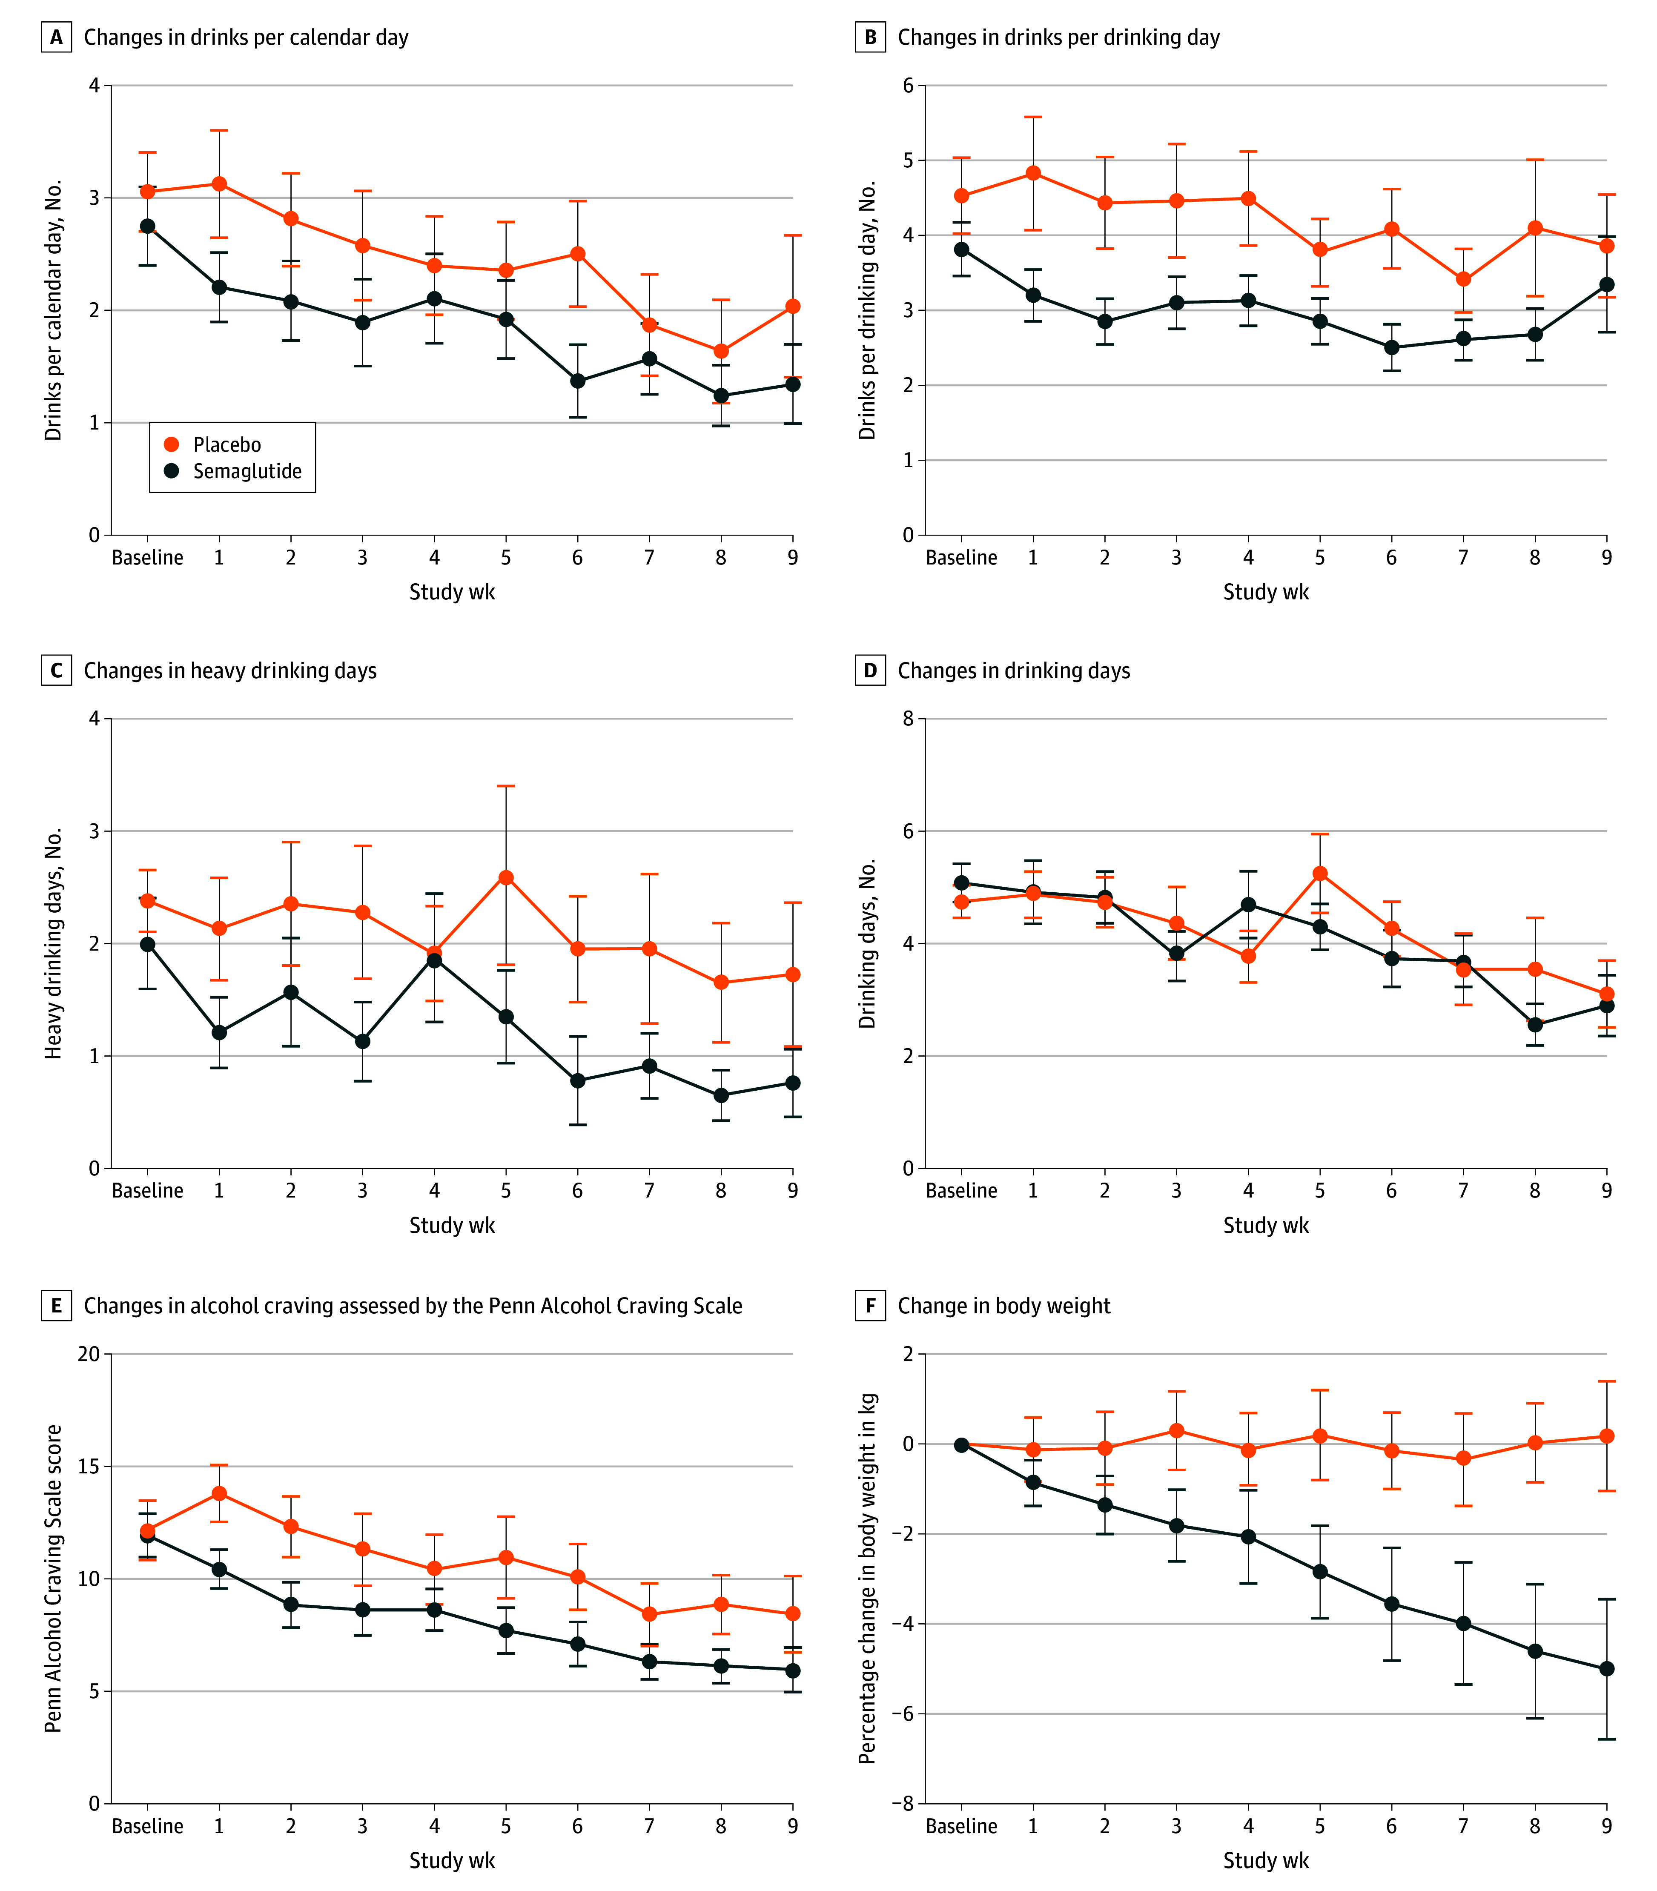
Recent RCT Semaglutide in Adults With Alcohol Use Disorder (cont.)

Slide 19
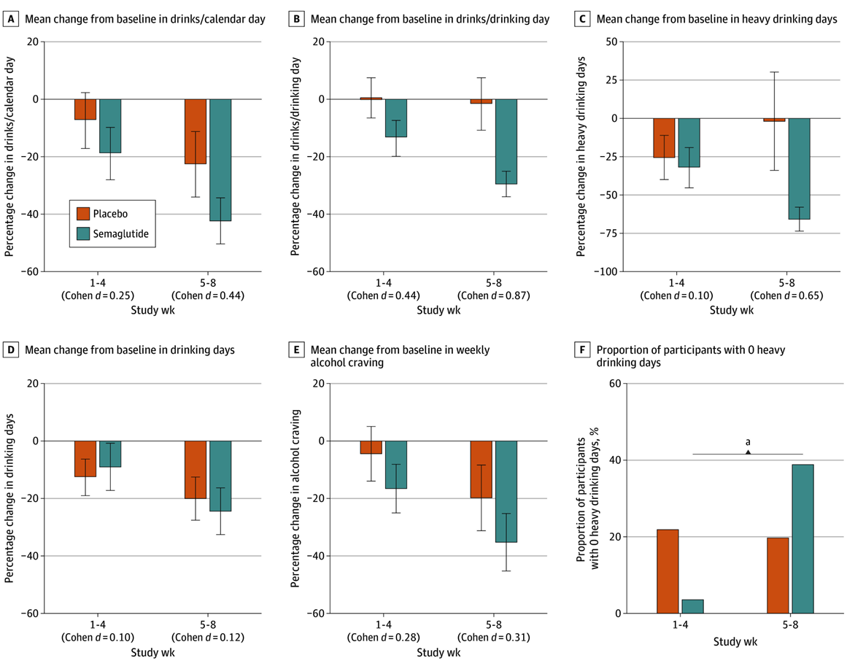
Recent RCT Semaglutide (cont.)

Slide 20
Recent Alcohol RCT Semaglutide: Drinks per Drinking Day Dermody SS et al. JAMA Psychiatry. 2025 Feb 12:e244789

Slide 21
Recent Alcohol RCT Semaglutide: Change in Body Weight Dermody SS et al. JAMA Psychiatry. 2025 Feb 12:e244789

Slide 22
Hints at Possible Mechanisms
CLP-1 receptor agonists remain in the brain for several hours after injection
Modulate brain circuits at multiple levels
GLP-1 agonists secreted in humans by:
Nucleus tractus solitarius (NTS)
Alpha cells in the pancreas
Enteroendocrine L cells in the distal intestine
GLP-1 receptors expressed in VTA and NAc (goal-orientated motivation), but also has widespread expression throughout the brain

Slide 23
Common Side-Effects
Gastrointestinal side-effects occur in up to 40% of people, with it interrupting treatment in 10%:
Nausea
Vomiting
Constipation
Diarrhoea
Nausea may be tolerated as helps to achieve weight loss goals
Notes:
Side effects of GLP-1 receptor agonists: Caution is needed until the harms are better understood (editorial) by Jennifer Manne-Goehler, and Juan Franco. BMJ 2025;390:r1606 http://doi.org/10.1136/bmj.r1606

Slide 24
Other Side-Effects
Regaining weight on discontinuing treatment (up to 50% of people) – so need to change lifestyle to avoid this happening
Loss of skeletal muscle (up to 39% of the total weight lost), with increased risk of sarcopenia - age related loss of muscle mass/strength (equivalent to adding on about an additional 20 years) – So need to engage in exercise to counter muscle loss
Increased risk of falls and frailty, especially in the elderly
Notes:
Side effects of GLP-1 receptor agonists: Caution is needed until the harms are better understood (editorial) by Jennifer Manne-Goehler, and Juan Franco. BMJ 2025;390:r1606 http://doi.org/10.1136/bmj.r1606

Slide 25
Rare Side-Effects
Non-arteritic anterior ischaemic optic neuropathy (NAION):
Loss of vision, with swelling of the optic disc, leading to irreversible optic atrophy, due to damage to the optic nerve thought to be due to insufficient blood supply, e.g. semaglutide
Found in observational studies
Suggested but not confirmed in better studies:
Acute pancreatitis
Pancreatic and thyroid cancer
Suicidal ideation
Notes:
Side effects of GLP-1 receptor agonists: Caution is needed until the harms are better understood (editorial) by Jennifer Manne-Goehler, and Juan Franco. BMJ 2025;390:r1606 http://doi.org/10.1136/bmj.r1606

Slide 26
Adverse Childhood Experiences (ACE’s)

Slide 27
Types of Adverse Childhood Experiences (ACEs): Stressful or Traumatic Events, Including Abuse and Neglect
Physical abuse
Sexual abuse
Emotional abuse
Physical neglect
Emotional neglect
Intimate partner violence
Mother treated violently
Substance misuse within household
Household mental illness
Parental separation or divorce
Incarcerated household member
Notes:
Physical neglect
Emotional neglect
Added in Wave 2 studies

Slide 28
7 Categories of ACEs (Score 1 for Every Category, Max. Score 7)
Category | No. Questions | Prevalence (%)
Psychological abuse | 2 | 11.1%
Physical abuse | 2 | 10.8%
Contact sexual abuse | 4 | 22.0%
Exposure to substance abuse | 2 | 25.6%
Exposure to mental illness | 2 | 18.8%
Exposure to violent treatment of mother or stepmother | 4 | 12.5%
Exposure to criminal behavior | 1 | 3.4%
Notes:
We used three categories of childhood abuse: (2 questions), (2 questions), or (4 questions). There
were four categories of exposure to household dysfunction during childhood:
(defined by 2 questions), (2 questions),
(4 questions), and (1 question) in the household. Respondents were defined as exposed to a category if they responded “yes” to 1 or more of the
questions in that category. The prevalence of positive
responses to the individual questions and the category
prevalences are shown in Table 1.
We used these for our analysis. The
measure of childhood exposure that we used was simply
the sum of the categories with an exposure; thus the
possible number of exposures ranged from 0 (unexposed) to 7 (exposed to all categories).

Slide 29
Prevalence of ACEs by Category for CDC-Kaiser ACE Study Participants
ACE Category | Women (%) | Men (%) | Total (%)
 | (N=9,367) | (N=7970) | (N=17337)
ABUSE AND NEGLECT
Emotional Abuse | 13.1% | 7.6% | 10.6%
Physical Abuse | 27.0% | 29.9% | 28.3%
Sexual Abuse | 24.7% | 16.0% | 20.7%
Emotional Neglect | 16.7% | 12.4% | 14.8%
Physical Neglect | 9.2% | 10.7% | 9.9%
HOUSEHOLD CHALLENGES
Mother Treated Violently | 13.7% | 11.5% | 12.7%
Household Substance Abuse | 29.5% | 23.8% | 26.9%
Household Mental Illness | 23.3% | 14.8% | 19.4%
Parental Separation or Divorce | 24.5% | 21.8% | 23.3%
Incarcerated Household Member | 5.2% | 4.1% | 4.7%

Slide 30
ACE Score Prevalence for CDC-Kaiser ACE Study Participants Felitti et al. Relationship of Childhood Abuse and Household Dysfunction to Many of the Leading Causes of Death in Adults: The Adverse Childhood Experiences (ACE) Study. Am J Preventive Medicine 1998, 14(4), 245-258
Number of ACEs (Score) | Women Percent (N = 9,367) | Men Percent (N = 7,970) | Total Percent (N = 17,337)
0 | 34.5% | 38.0% | 36.1%
1 | 24.5% | 27.9% | 26.0%
2 | 15.5% | 16.4% | 15.9%
3 | 10.3% | 8.5% | 9.5%
4 or more | 15.2% | 9.2% | 12.5%

Slide 31
ACEs and Substance Misuse
ACEs can predict earlier age of drinking onset
Each additional ACE increased by 2 to 4 times the likelihood of early initiation into illicit drug use, i.e. gateway effect seen only if multiple ACEs
Each additional ACE increases the number of prescription drugs used by 62%
Prevalence of current and ever smoking increased as ACEs increase
A person’s ACE score has a strong graded relationship to numerous health, social, and behavioural problems throughout life
Notes:
Early initiation of alcohol use. Efforts to prevent underage drinking may not be effective unless ACEs are addressed as a contributing factor. Underage drinking prevention programs may not work as intended unless they help youth recognize and cope with stressors of abuse, household dysfunction, and other adverse experiences. Learn more from a 2008 study on how ACEs can predict earlier age of drinking onset. (link is external)
Higher risk of mental and substance use disorders as an older adult (50+ years). ACEs such as childhood abuse (physical, sexual, psychological) and parental substance abuse are associated with a higher risk of developing a substance use disorder. Learn more from a 2017 study on adverse childhood experiences and mental and substance use disorders as an adult (link is external).
Continued tobacco use during adulthood. Prevalence ratios for current and ever smoking increased as ACEs scores increased, according to a 2011 study on ACEs and smoking status.
Prescription drug use. For every additional ACE score, the rate of number of prescription drugs used increased by 62%, according to a 2017 study of adverse childhood experiences and adolescent prescription drug use. (link is external)
Lifetime illicit drug use, drug dependency, and self-reported addiction. Each ACE increased the likelihood of early initiation into illicit drug use by 2- to 4-fold, according to a 2003 study on childhood abuse, neglect, and household dysfunction and the risk of illicit drug use.

Slide 32
As the Number of ACEs Increases, esp. ≥ 4, the Risk Increases for the Following
Alcoholism & alcohol abuse
Illicit drug use
Chronic obstructive pulmonary disease
Ischemic heart disease
Liver disease
Depression
Suicide attempts
Health-related quality of life
Poor work performance
Poor academic achievement
Financial stress
Smoking
Early initiation of smoking
Multiple sexual partners
Sexually transmitted diseases
Risk for sexual violence
Risk for intimate partner violence
Unintended pregnancies
Early initiation of sexual activity
Adolescent pregnancy
Foetal death

Slide 33
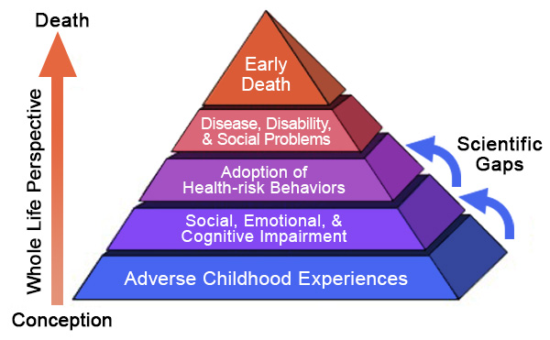
Relationship of ACEs to Risk Factors for Issues & Addiction–The ACE Pyramid
Heath issues & Overdose
Addiction
Drug use
Charles Whitfield, Centers for Disease Control and Prevention
Notes:
https://www.samhsa.gov/capt/practicing-effective-prevention/prevention-behavioral-health/adverse-childhood-experiences
The Adverse Childhood Experiences Study (ACE Study) is a research study conducted by the American health maintenance organization Kaiser Permanente and the Centers for Disease Control and Prevention.[1] Participants were recruited to the study between 1995 and 1997 and have been in long-term follow up for health outcomes. The study has demonstrated an association of adverse childhood experiences (ACEs) (aka childhood trauma) with health and social problems across the lifespan.

Slide 34
If We Have Over Four ACE’s, What Can we Do to Help Ourselves
We can be aware of our risks
We can be proactive (if ≥ 4 ACE’s):
We can take preventative action now to reduce our risks
We take action to get treatment quickly if an issue or illness develops
We can work on our traumas/hangups over the long term, to minimise their negative impact in our life

Slide 35
Attachment Styles

Slide 36
Effect of Attachment Styles & Learnt Strategies in Life and Life Experiences
Our attachment style has been shown to impact our identity and our emotional wellbeing as adults in a variety of ways:
Our friendships
Our choice of significant others
The quality of our romantic relationships
The kind of caregivers or parents we become
Our children’s sense of security and emotional wellbeing

Slide 37
Attachment Patterns in Babies
Secure attachment (62%) – attunement:
Parent ‘reads the baby’ – consistently picking up on baby’s emotions/behaviour and responds to their needs in an appropriate and timely manner
Lowest risk of identity issues & addiction problems
Insecure attachment (38%) – lack of attunement:
Higher risk of identity issues & addiction problems
3 types of insecure attachment:
Avoidant attachment (15%)
Anxious or ambivalent attachment (9%)
Disorganised attachment (15%)

Slide 38
Attachment and Parental Responses
Avoidant Attachment (15%):
Parent either does not respond positively to the baby’s emotions/ behaviour or is rejecting of the baby’s needs
Anxious (Ambivalent) Attachment (9%):
Parent responds inconsistent to the baby’s emotions/ behaviour (sometimes responds, sometimes doesn’t)
Disorganised Attachment (15%):
Parent is source of distress/trauma to the child, as they are inconsistent and at times threatening to the child. Commoner if economic and family instability is present. It can pass down the generations from parent to child
Notes:
Disorganised Attachment: too preoccupied with own issues/trauma or don’t know how to be an adult & want child to comfort them.

Slide 39
Little Relationship Between Attachment Style and Socio-Economic Status (SES)
No general relationship:
i.e. ‘nice’ middle class people have all types of attachment to their babies
However disorganised attachment is more common in the lower SES group, and is associated with higher financial & relationship stress
Also, no relationship to baby’s gender and the baby's basic temperament

Slide 40
15% Avoidant Attachment
Parent does not respond positively to the baby’s emotions/ behaviour and doesn’t respond or is rejecting of the baby’s needs:
Baby inhibits own expressions of distress or anger to avoid driving parent further away
Baby looks like nothing bothers them, but have high physiological arousal, i.e. they are hiding it
Children develop strategies to control emotional arousal: use drugs/ alcohol, food, exercise, sex etc.
Adults tend to psychological avoidance/minimising. Difficulty expressing emotions, value thoughts over emotions, mistrust and anxious in relationships

Slide 41
9% Anxious (Ambivalent) Attachment
Parent is inconsistent in responding to the baby’s emotions/ behaviour and sometimes responds to them and sometimes doesn’t:
Baby ups the anti to get parent’s attention, by being demanding/noisy/clingy and being hard to soothe
Develop strategies to avoid personal responsibility, exonerate self and blame others. Want others to change not themselves, so slow learners. Poor decision making leads to drugs/ alcohol use etc.
Enmeshed style of relating – seek closeness but also push away, mistrust/ anxious in relationships

Slide 42
15% Disorganised Attachment
Parent is source of distress/trauma to the child, as they are inconsistent and at times threatening to the child (too preoccupied with own issues/trauma or don’t know how to be an adult & want child to comfort them). Commoner if economic and family instability:
Baby can’t figure out a strategy to engage with the parent and can’t find a strategy that works consistently for them
Baby lacks internal sense of safety & can’t discern between dangerous and safe situations/ people
As children/adults often get (re-)traumatised, DV/rape etc.
Difficult to distinguish effects of trauma and disorganised attachment, and don’t feel good enough
Have chaotic/unhealthy relationships with people/things. Drug/alcohol use is an expression of chaos in life

Slide 43
Disorganised Attachment is an Indicator of how Issues in Our Society
Disorganised attachment is found in a massive 15% of babies (avoidant & anxious attachment in another 24% is bad too)
Disorganised attachment results in:
A vulnerability to subsequent trauma (e.g. rape, DV), as they have not learnt to protect themselves
It passes down the generations, as one cause of disorganised attachment is a traumatised adult
In children & adults, it is difficult to distinguish the effects of trauma from the underlying attachment
This group cost society a lot of money, as they are the ones requiring services/psychiatric help

Slide 44
Overcoming Our Insecure Attachment
When people feel secure, they can grow:
In secure healthy intimate relationships
Healing through counselling etc.
We need to learn about appropriate boundaries in relationships, as these were not modelled to us
As parents, we can be taught how to attune to the baby, esp. avoidant & anxious types
If have children, we can take a parenting course, so we don’t pass it on to our kids

Slide 45
Stress and Trauma Syndromes (from the psychiatric point of view)

Slide 46
Trauma - An Over Used Term
Trauma has come to mean any unpleasant event or experience. One counsellor said even being loved too much was a trauma
We all experience negative events in life (e.g. ACE’s), and most of the time they have no lasting physical or psychological impacts, i.e. trauma does not necessarily traumatise
In psychiatry, we are traumatised when we have lasting psychological impacts

Slide 47
What is a Traumatic Event in Psychiatry?
Traumatic events are defined as experiences that put either the person or someone close to them at risk of actual or threatened death, serious injury or sexual violence
These can include:
Road accidents
Violence/abuse
Natural disasters
Serious illnesses

Slide 48
Why do Some People Get Traumatised and Others Not?
The severity of the threat or injury
An incident is only traumatic if it is not properly processed, leading to persistent issues, and the strongest predictor is previous trauma
Unresolved trauma causes many mental health problems more commonly than it causes PTSD, e.g. sleep, anxiety, depression, substance use
Unresolved trauma contributes to many physical health problems, e.g. obesity, heart disease, and autoimmune conditions

Slide 49
Effects of Potentially Traumatic Events on Mental Health
No lasting mental health effects
Substance use
Sleep disturbance
Anxiety and depression
Dissociative disorders
Other trauma and/or stressor related disorders:
Acute stress disorder and Adjustment disorder
Bereavement related disorder
PTSD, cPTSD, and DID

Slide 50
What is Trauma Informed Care?
Trauma informed care:
Basic safety, care and understanding of trauma, so we don’t make traumatised people worse, e.g. HCPs
Trauma competence:
Able to recognise trauma and refer people for treatment, e.g. most doctors, therapists
General trauma treatment:
Provide treatment services but not specialised in trauma, e.g. general psychiatry services
Specialised/expert trauma treatment:
Trauma specialists, provide EMDR, tfCBT etc.

Slide 51
Principles of Trauma Informed Care (to avoid making traumatised people worse)
Ensure they feel emotionally and physically safe
Be trustworthy, listen, explain & be transparent
Offer choices (if there is one), and validate their concerns as understandable and normal
Collaborate with them and ask about their needs
Empower them and be non-judgemental
Be culturally aware

Slide 52
Public Health Model - Public Education, Community Resilience, Safety, Prevention, Vigilance, Effective Intervention and integrated healthcare
Expert Advice/Treatment
Trauma Services
Trauma Informed Care
Community Interventions
Prevention Interventions

Slide 53
5 Main Types Reactions to Stress in Adults in ICD-10/11 and DSM-5
Acute stress reaction:
Onset within 1 hour of an exceptional stressor
Anxiety plus ‘daze’, depression, anger, despair etc
Resolves rapidly, usually within a few hours (if stressor stops) or 3 days (even if stressor continues)
Adjustment disorder:
Onset usually within 1 month of stressor or life change
Resolves usually within 3 (DSM) or 6 months (ICD)
Prolonged grief disorder:
Grief has not resolved within 6 months

Slide 54
Reactions to Stress in Adults in ICD-10/11 and DSM-5 (cont.)
PTSD (post traumatic stress disorder):
Onset usually within 6 months of exceptional stressor
Intrusions (flashbacks), avoidance, inability to recall part or all of the event or hyperarousal
Complex PTSD or cPTSD (ICD-11 only):
Onset following an event or series of events of an exceptional nature, especially where escape is difficult or impossible, e.g. childhood abuse
PTSD symptoms, plus disturbances in self-organisation (DSO) in 3 areas: mood, self-belief & relationships

Slide 55
Issues Not in Diagnostic Systems
Moral injury:
Psychological, social and physical suffering stemming from actions taken by oneself or observations of others made during traumatic events or circumstances which are a violation of one’s moral beliefs and values
Originally applied to military personnel, but now is applied to HCPs and first responders
Vicarious trauma:
Emotional residue from listening to trauma stories
Secondary traumatic stress:
PTSD after hearing about first hand trauma experiences

Slide 56
Other Problems with Stress Diagnoses
All diagnoses refer to external stressors:
But PTSD symptoms commonly occur after childbirth, heart attack, cancer diagnosis etc
PTSD onset within 6 months of stressor:
But onset may only occur when someone is sufficiently safe, e.g. asylum seekers
Where ongoing trauma has occurred, it may be very unclear when the symptoms started
DSO symptoms in cPTSD have many causes

Slide 57
PTSD Following Childbirth Mother and/or their child perceived as being in actual or threatening danger of death or severe injury during childbirth
1 - 3% incidence where pre-existing PTSD or depression in pregnancy excluded
0 - 8% (av. 4.7%) in normal populations when pre-existing conditions are included
20 - 29% if severe complications during pregnancy/labour or foetal/infant loss
BUT subjective birth experience is more important in determining the outcome than the objective events of labour
Notes:
Maternal childbirth-related PTSD and/or PTSD symptoms (CB-PTSD(s)) can be defined as the occurrence of PTSD symptoms in mothers who experienced themselves and/or their child as being in actual or threatening danger of death or severe injury during childbirth. The mean prevalence of maternal CB-PTSD is estimated to be 4.7 % [10].
The subjective birth experience is more important in determining women's psychological responses to birth than objective events of labor (Garthus-Niegel et al., 2013, 2014; Ozer et al., 2003).
Postpartum posttraumatic stress disorder (PTSD) following a traumatic birth experience, has particularly attracted increasing attention (Alcorn et al., 2010; Ayers and Pickering, 2001). There are varying estimates of the prevalence of postpartum PTSD, with studies reporting from 0% to 8% in normal populations (Adewuya et al., 2006; Alcorn et al., 2010; Ayers et al., 2009; Czarnocka and Slade, 2000;Soet et al., 2003; White et al., 2006; Wijma et al., 1997) and around 20% to 29% in high-risk groups such as women who have severe complications during pregnancy and labor or fetal or infant loss (Poel et al., 2009; Turton et al., 2001). Studies that recruit mothers from the community and exclude women with pre-existing PTSD or depression in pregnancy provide converging evidence that the incidence is likely to be between 1 and 3% (Alcorn et al., 2010; Ayers and Pickering, 2001).

Slide 58
Acute Stress Disorder and PTSD Following an MI
Acute stress and adjustment disorder (within first month):
0-26% self-report questionnaires
2.6-3.6% structured diagnostic clinical interviews
PTSD (after first month):
16% self-report questionnaires
4% structured diagnostic clinical interviews
Prevalence rates fall in first 1-2 years
One-third continued to have PTSD at 2 yrs
Notes:
A small number of the included studies showed that the percentage of people who developed an ASD during their hospital stay or 1 month after MI was between 0% and 26% (Castilla & Vázquez, 2011; Fortin et al., 2013; Gao et al., 2015; Ginzburg & Ein-Dor, 2011; Meister et al., 2015; Meister, Weber, et al., 2016). The prevalence rates for ASD tended to be higher when self-report questionnaires were used (0%–26%) versus when diagnostic interviews were used (2.6%–3.6%). As with ASD prevalence rates, PTSD prevalence rates secondary to an MI event were higher when measured using self-administered questionnaires versus structured diagnostic interviews. For example, the prevalence rates of post-MI PTSD assessed using self-administered questionnaires ranged from 3% to 19%. More generally, results reported in a meta-analysis study (N = 2,383) showed a PTSD prevalence of 12% when assessed an average of 5 months after an acute coronary event; these rates were estimated to be 16% when measured using self-administered questionnaires and 4% when measured using structured diagnostic clinical interviews (Edmondson et al., 2012).

Slide 59
PTSD Following Threat of Death from MI, Stroke and Cancer
12–25% survivors of acute life-threatening medical events develop PTSD
Presence of PTSD associated with:
Poorer physical functioning and quality of life
Presence of PTSD after MI or unstable angina:
Double the risk of recurrence and mortality relative to those who didn’t develop PTSD
Probably due to autonomic imbalance, ↓ sleep, ↑ systemic inflammation, ↓ medication adherence
Notes:
The potential for PTSD due to life-threatening illness has been studied most in cancer, acute coronary syndrome (ACS; myocardial infarction or unstable angina), and increasingly, stroke patients. While individual studies offer prevalence estimates for medically-induced PTSD that vary widely, from 0% to more than 30%, large observational studies and metaanalytic estimates within each literature have returned fairly consistent estimates of approximately 12-25% (Edmondson & Cohen, 2013; Edmondson et al., 2012; Edmondson, Richardson, et al., 2013).

Slide 60
Examples of PTSD from Internal/ External and Acute/Chronic Sources
 | Acute Treat Discrete threat to life or serious injury | Chronic Threat Ongoing fear of death or abuse/neglect events
Event external to the body | RTA, assault, natural disaster, unexpected death of a loved one | Ongoing abuse or neglect as a child or adult, e.g. CSA, DV, torture, genocide
Event within the body | Severe pain from childbirth, injury or operation, broken limb | Conditions with ongoing risk – cancer, stroke, CVD e.g. MI, unstable angina
Both of the above | Temporary severe pain from injury or difficulty caused by external factors | Conditions with ongoing risk or disability caused by external factors

Slide 61
Intrusions (I), Avoidance (Av) and Arousal (Ar) with Different Events
 | Acute Treat Discrete threat to life or serious injury | Chronic Threat Ongoing fear of death or abuse/neglect events
Event external to the body | I: past oriented; Av: possible Ar: due to external events | I: future oriented; Av: difficult Ar: due to external events
Event within the body | I: past oriented; Av: possible Ar: due to internal events | I: future oriented; Av: difficult Ar: due to internal events
Both of the above | I: past oriented; Av: possible Ar: triggered by both internal & external events | I: future oriented; Av: difficult Ar: triggered by both internal & external events
Adapted from Edmondson D. An enduring somatic threat model of posttraumatic stress disorder due to acute life‐threatening medical events. Social & Personality Psychology Compass. 2014 Mar;8(3):118-34
Notes:
Edmondson D. An enduring somatic threat model of posttraumatic stress disorder due to acute life‐threatening medical events. Social and Personality Psychology Compass. 2014 Mar;8(3):118-34.

Slide 62
PTSD in DSM-5 (2013)
Directly experiencing or witnessing actual or threatened death, serious injury or sexual violence or learning it has occurred to a loved one
Changes present for > 1 month associated with functional impairment:
Presence of intrusive symptoms associated with the traumatic event
Presence of negative cognitions and associated mood symptoms
Changes in arousal and reactivity associated with the traumatic event

Slide 63
3 Main Types of Trauma Syndromes
PTSD:
Typically one or small number of events as an adult, e.g. assault, rape, RTA, natural disaster
Complex PTSD (cPTSD):
Multiple events as a child or adult, e.g. sexual, physical, psychological abuse or neglect, military trauma
DID (Dissociative Identity Disorder, previously called multiple personality disorder):
Multiple events in childhood, typically starting prior to 5 years of age (and often with events continuing)

Slide 64
Point Prevalence of Trauma and Trauma Syndromes
Childhood sexual abuse:
1 in 6 girls and 1 in 20 boys (UK Independent Inquiry into Child Sexual Abuse, Oct 2022)
PTSD:
1% general population (3.5% USA), 3.5% if assaulted
3.5% unwounded soldiers, 20% wounded soldiers
Complex PTSD:
1-8% (average 5%) general population
16-38% refugees and asylum seekers
DID:
1.5% general population
Notes:
7.8% general population
28.8% at 1 month post trauma
17% at 1 year post trauma
(13% lifetime prevalence of cPTSD

Slide 65
Dissociation – Normal, Behind the Scenes and Clinically Obvious
Normal: A normal day to day psychological process, but to different degrees in different people, e.g. drive somewhere familiar but not recall the journey
Behind the scenes: When traumatised, we may develop PTSD, cPTSD or DID where the survival strategy to overwhelming stress is to separate (dissociate) the emotions, thoughts and feelings about the event
Clinically: Clinical dissociation is a disruption and/or discontinuity in the normal integration of consciousness, memory, identity, emotion, perception, body representation, motor control and behaviour

Slide 66
Measure Level of Dissociation Using the Dissociative Experiences Scale (DES)
Typical average scores on the 28 item DES out of 100:
3-8 general population
4-13 mood and anxiety disorders
10-20 schizophrenia and bipolar disorder
30-40 PTSD and DDNOS (dissociative disorders not otherwise specified, which probably includes cPTSD)
40-60 DID
Notes:
Dissociative Experiences Scale (DES) and obtained a high average score on all items of XXX (scale range 0-100). The questionnaire lists 28 experiences of daily life and asks the client to circle the number from 0 to 100 which show what percentage of the time they have the experience. The total score is calculated as the average score on all 28 items. Scores ≥ 30 are indicative of severe dissociation, and for Dissociative Identity Disorder (DID) has a sensitivity of 74% and a specificity of 84%. If the score is ≥ 30, and they do not have DID, then 83% will have PTSD, complex PTSD or another dissociative disorder. The average scores for

Slide 67
What is Happening when we Dissociate in PTSD?
An event is experienced as emotionally overwhelming, so the brain splits the experience into components:
Dividing up the memory into fragments, and/or
Separating the thoughts about it from the emotional feelings and physical sensations attached to it
Dissociation is “a normal response to an abnormal event” and a survival strategy

Slide 68
Effects of Fragmenting Memories
Intrusive experiences (re-experiencing):
Flashbacks from traumatic memories, thoughts, feelings and sensations, suddenly entering mind
Avoidance of triggers:
Aiming to avoid anything that may trigger intrusive experiences or increased anxiety
Physiological arousal:
Difficulty going to sleep or staying asleep, difficulty concentrating, anxious, irritable, anger, hypervigilant, startle response

Slide 69
Screening for PTSD
Various questionnaires available, including the IES-R (Impact of Event Scale – Revised) used to assess subjective distress
Most researched of all trauma scales
Score 24-32 of clinical concern, ≥ 33 probable PTSD, ≥ 37 have a suppressed immune system
Problems with the IES-R:
Need to specify a specific trauma, choosing the one causing most distress – intrusions etc.
Not so helpful where multiple traumas are present (use Trauma Symptom Inventory 2nd ed)

Slide 70
Complex PTSD (cPTSD)
Complex PTSD occurs following recurrent, chronic or sustained traumas beginning after the age of 5 years (e.g. abuse or neglect) often by a parent or caregiver, where escape is difficult or impossible
Child blames themselves rather than abuser, as it is psychologically safer to do so, as they depend on the abuser for food, clothes & shelter
BUT complex PTSD may develop after a single event, and multiple events may lead to simple PTSD (and not complex PTSD)
Notes:
Typically (in addition to PTSD symptoms), it affects people’s perceptions of themselves, e.g. that they are evil, or that they caused it

Slide 71
Symptoms of Complex PTSD
Includes symptoms of PTSD
Plus
Difficulties with self-organisation (DSO) reflecting the prolonged impact of early sustained attachment trauma:
Problems in affect (mood) regulation, such as irritability, anger, feeling emotionally numb
Negative self-concept, believing oneself to be diminished, defeated or worthless, with feelings of shame, guilt or failure related to the trauma
Difficulties sustaining interpersonal relationships and in feeling close to others

Slide 72
Recognition of Complex PTSD in the Diagnostic Systems for Mental Disorders
Newly recognised in ICD-11 by WHO (2019)
Good evidence that PTSD and complex PTSD are conceptually different (construct validity)
Does not include clinical dissociation (which is a marker for severity and more functional impairment)
Not recognised in DSM-5 by the APA (2013)
But PTSD does include a 4th set of symptoms (not included in ICD-11) with changes in mood and cognition and the presence or absence of dissociation (disruption of identity, sensations, perceptions etc)
May appear in DSM-6 as ‘Disorders of extreme stress’

Slide 73
‘International Trauma Questionnaire’ (ITQ) to Screen for Complex PTSD
Problems with the Complex PTSD diagnosis:
The 3 issues with disorganisation may be due to many things, not just trauma
When someone has a history of trauma and comorbidity, it is often difficult to decide what to attribute the symptoms to
Problems with the ITQ:
1st section is related to a specific trauma
Although validated, it is brief at 2 pages
It misses many people with PTSD (false negatives)

Slide 74
Differentiating Other Disorders and cPTSD
ADHD (attention deficit hyperactivity disorder)
Look for inattention and distractibility
ASD (autistic spectrum disorder)
Look for sensory sensitivity and communication strategies
DID (dissociative identity disorder)
Look for auditory hallucinations and amnestic episodes after early severe attachment trauma
EUPD (emotionally unstable personality disorder – impulsive or borderline types)
More likely to DSH or be suicidal, more rapid mood shifts, less stable negative self-concept, and as a personality disorder it has to have begun in adolescence or earlier

Slide 75
Symptoms of DID (Dissociative Identity Disorder)
Typically, but not always, includes symptoms of cPTSD (but not part of formal diagnostic criteria)
Plus
Disruption in identity (reported by the person or observed by others) characterised by:
Two or more distinct personality states
Marked discontinuity in sense of self and sense of agency, with related alterations in affect (mood), behaviour, consciousness, memory etc
Recurrent gaps in the recall of everyday events, important personal information and/or traumatic events
Notes:
e.g. accused of lying when don’t think have done so

Slide 76
Additional Issues in DID (previously called multiple personality disorder)
Different personalities typically with limited access to each other (not just different mental states in the same personality) – so may communicate using notes
The person may be aware they have different personalities, and call them by different names and be able to describe their characteristics
May be male/female, old/young, nice/horrible, angry/accusatory/violent, intelligent or not
Often experience internal (dissociative) voices, which can be mistaken for psychosis or ‘possession’

Slide 77
The Value and Drawbacks of Psychiatric Diagnosis
Having a diagnosis can be valuable if:
People identify with it – it makes sense of their symptoms
If it guides helpful treatment for them and their clinicians
Having a diagnosis can be harmful if:
They are seen as set in stone, rather than as an opportunity to discuss how likely it is
It is not positively received or hinders access to help or is used to exclude people

Slide 78
Diagnosis of Psychiatric Disorder
PDs often used to exclude people from services
PD is not a reliable diagnosis
PD diagnosis made even if didn’t begun in adolescence or earlier (one of the criteria), so psychiatrists are being lazy or taking shortcuts
Childhood sexual abuse often begins in adolescence or earlier, which often leads to complex PTSD and ‘borderline processing’, the symptoms of which overlap with PD, e.g. borderline PD
Need to treat such people for complex PTSD to find out if they respond to treatment

Slide 79
Treatment of Trauma Syndromes

Slide 80
Treatment Involving Revisiting the Trauma Without Getting Overwhelmed
PTSD:
Process/integrate the memories while regulating the intense feelings/arousal activated
Complex PTSD:
Above plus change the defensive habits/ learned behaviour strategies that are no longer adaptive
DID (Dissociative Identity Disorder):
Above plus encourage different personas to communicate with and cooperate with each other (which may or may not lead to integration)

Slide 81
The 3 Phase Treatment Strategy for Trauma Syndromes – PTSD, cPTSD and DID (Int. Society for Traumatic Stress Studies Treatment Guidelines)
Stabilisation of our emotions and improving our sense of safety:
Education, work on self-care and social networks, focus on managing hyperarousal and dissociation
Processing: Remembering & expressing the trauma
Consolidate, integrate & rehabilitate the trauma
Connection with others and life in the present, over-coming social isolation and loneliness
4th step: Re-evaluation of life and its meaning:
Post-traumatic growth (including spirituality)

Slide 82
Post-Traumatic Growth Questionnaire Tedeschi, R.G., & Calhoun, L.G. (1996). The Posttraumatic Growth Inventory: Measuring the positive legacy of trauma. Journal of Traumatic Stress, 9, 455-471
To identify potentially positive aspects things that have come out of experiencing trauma
Only complete when you have done trauma processing
Relating to Others (7 items):
E.g. I put more effort into my relationships
New Possibilities (5 items):
E.g. I developed new interests
Personal Strength (4 items):
E.g. I have a greater feeling of self-reliance
Spiritual Change (2 items):
E.g. I have a stronger religious faith
Appreciation of Life (3 items):
E.g. I can better appreciate each day
21 items
Notes:
Tedeschi, R.G., & Calhoun, L.G. (1996). The Posttraumatic Growth Inventory: Measuring the positive legacy of trauma. Journal of Traumatic Stress, 9, 455-471

Slide 83
All Trauma is Eminently Treatable with a Good Prognosis - with the Best Treatment
PTSD (use EMDR or tfCBT):
Full recovery, i.e. no interference with day to day functioning, within one or a few treatment sessions
cPTSD (use specific therapies):
Full recovery, i.e. without intrusive memories causing distress, typically within a few months or a year or two
DID (use specialised treatment):
Full recovery, i.e. stable & functioning personality without distress, within several to many years

Slide 84
Availability of Trauma Treatment where aim to resolve distress caused by the symptoms
PTSD:
Very limited availability in NHS even for simple PTSD, despite it being relatively easy to treat, but availability is increasing. More in private care
Complex trauma:
NHS may provide support, but no specific treatment. Some treatment from charities or privately
DID:
Limited NHS non-specific trauma support only. Some charity work

Slide 85
NICE on Psychological Treatments for PTSD in Adults (NG 116, 2018)
If presented >1 month post-trauma, offer 8-12+ individual trauma-focused CBT (tfCBT) sessions:
Cognitive processing therapy
Cognitive behaviour therapy for PTSD
Narrative exposure therapy
Prolonged exposure therapy
For non-combat related trauma:
Presented after 1-3 months, consider 8-12+ EMDR sessions if the person has a preference for EMDR
If after 3 months, offer EMDR only if not responded or engaged with tfCBT (or use computerised tfCBT if preferred to others if symptoms not too severe)
Notes:
Consider EMDR for adults with a diagnosis of PTSD or clinically important symptoms of PTSD who have presented between 1 and 3 months after a non-combat-related trauma if the person has a preference for EMDR. [2018]
Offer EMDR to adults with a diagnosis of PTSD or clinically important symptoms of PTSD who have presented more than 3 months after a non-combat-related trauma. [2018]
Consider supported trauma-focused computerised CBT for adults with a diagnosis of PTSD or clinically important symptoms of PTSD who have presented more than 3 months after a traumatic event if they prefer it to face-to-face trauma-focused CBT or EMDR as long as:

Slide 86
NICE on Medication Treatments for PTSD in Adults
Consider venlafaxine (off-label) or a SSRI (e.g. sertraline, paroxetine) if the person has a preference for drug treatment
Consider antipsychotics (e.g. risperidone) in addition to psychological therapies if they have disabling symptoms and behaviours or they have not responded to other drug or psychological treatments
Do not offer drug treatments, including benzodiazepines, to prevent PTSD developing
Notes:
Consider EMDR for adults with a diagnosis of PTSD or clinically important symptoms of PTSD who have presented between 1 and 3 months after a non-combat-related trauma if the person has a preference for EMDR. [2018]
Offer EMDR to adults with a diagnosis of PTSD or clinically important symptoms of PTSD who have presented more than 3 months after a non-combat-related trauma. [2018]
Consider supported trauma-focused computerised CBT for adults with a diagnosis of PTSD or clinically important symptoms of PTSD who have presented more than 3 months after a traumatic event if they prefer it to face-to-face trauma-focused CBT or EMDR as long as:

Slide 87
Many Commonly Used Treatments for PTSD Helpful but are NOT Curative
Talking therapy (psychodynamic therapy):
Telling the story of the event, i.e. Freud and Brewer were wrong, as need the person to stay within the ‘Window of Tolerance’ to ‘metabolise’ a trauma
Adapted psychodynamic therapy may help
EMDR (eye movement desensitisation and reprocessing)
tfCBT (trauma focussed CBT):
Recommended as first line for trauma by NICE

Slide 88
Other Therapies Supported by Evidence Assisting with Trauma Processing
Exposure therapy:
Repeatedly re-experiencing the trauma
Trauma focused mentalisation
Mentalizing applied to trauma involves understanding how one’s mental state influences emotions and behaviour
Art therapy
Sensorimotor psychotherapy
Sees the body as an integral source of information to guide processing of traumatic and other experiences
Somatic experiencing and body-based therapies, including trauma sensitive yoga

Slide 89
The Importance of the Window of Tolerance in Understanding Trauma

Slide 90
Narrowed Window of Tolerance When Traumatised

Slide 91
The Significance of Staying in the Central Window
When traumatised, we may spend most of our time in the lateral windows
Our aim is to widen our window of tolerance, by developing techniques to manage our distress
So we must work to keep our ANS balanced, as we can only make progress if we can stay in the central window while re-experiencing trauma memories,
Therapies for PTSD aim to help us stay within the central window, allowing us to revisit the trauma and process it without getting overwhelmed – keep our higher brain systems online (thalamus & frontal lobe)

Slide 92
Keeping the Autonomic Nervous System in Balance While Processing the Trauma
SNS (‘the accelerator’) is predominant in flight/ fight and has activated our body, heightened our alertness, and released adrenaline to prepare us for threat
PNS (‘the break’, which includes the vagus nerve) is predominant in freeze/withdrawal and deactivates our body, calms us down and makes us less aroused, so we “rest and digest”

Slide 93
Managing the ANS using ‘Calming Breathing’ and ‘Box Breathing’
Breathing air out stimulates the PNS:
When we are in flight/fight (hyperarousal), we need to calm our mind and body down. ‘Calming breathing’ involves breathing out for twice as long as we breath in, e.g. breath in to the count of 2-3, out to the count of 4-6
Breathing air in stimulates the SNS:
When in freeze/withdrawal (hypoarousal), we need to use grounding and box breathing to stimulate the SNS
‘Box or window breathing’ involves breathing in to the count of 4, holding to the count of 4, breathing out to the count of 4, holding to the count of 4 and repeat

Slide 94
The Brain Structures Involving in Trauma and Trauma Processing
The amygdala as our smoke alarm:
When we are triggered, the ‘smoke alarm’ goes off if there is anything indicative of fire around, although most of the time it is a false alarm (like burnt toast, rather than danger)
When fragmented memories occur as in trauma syndromes, the frontal lobe and thalamus have shut down, and the emotional brain (limbic area & brain stem) takes over
To process trauma, we need to get structures back online:
Frontal lobe: Needed to put feelings into words and to create our sense of location in time
Thalamus: Integrates raw data of incoming sensations from our external and internal environments

Slide 95
Things Interfering with the Effectiveness of Counselling and Trauma Processing
Trauma processing reduces PTSD symptoms, but not reduce the DSO symptoms of cPTSD, so need additional interventions to makes processing more effective
Additional interventions shown to help:
Learning distress tolerance and emotional self-regulation strategies
DBT (dialectical behavioural therapy) or narrative therapy combined with skills training in affect (mood) and interpersonal regulation
Shame can interfere with the effectiveness of counselling, so needs to be tackled directly (next slides)

Slide 96
Impact of Shame and Guilt on Outcome
Shame involves negative evaluations of the entire self, whereas guilt involves negative evaluations of specific actions or behaviours
Shame is a better predictor of poorer outcome than guilt
High shame is associated with poorer outcomes from standard treatments, indicating that the treatment need to be tailored to effectively target shame
Notes:
Trauma-Related Shame Inventory (TRSI-24): the 24 item Trauma-Related Shame Inventory how much particular statements are true for them over the past week. It measures 4 categories of shame, each represented by 6 items. The composite scores for Internal shame score was 7, for External shame score was 2, for Condemnation shame was 7 and for Affective-behavioural shame was 2. Shame involves negative evaluations of the entire self (whereas guilt involves negative evaluations of specific actions or behaviours). She has the highest score on Internal condemnation, in which one evaluates oneself as flawed, weak, inadequate or disgusting (personal condemnation). It is thought to occur when a person personalises the traumatic experience and views trauma as confirming evidence of personal failure. This judgmental or critical stance towards the self, is associated with low self-compassion, high self-criticism and low-self-esteem as well as depression. This is in contrast to her very low scores on External Shame which is to do with how others will see/appraise or evaluate them and on Perceived Condemnation (fear of being devalued, scored or ridiculed, exposed and rejected by others) and Affective-Behavioural (tendency to want to hide, disappear or withdraw). The significance of high shame (or guilt) is that it is associated with poorer outcomes from standard treatments, and indicates that the treatment need to be tailored to effectively target shame

Slide 97
Measuring Shame – The Trauma-Related Shame Inventory (TRSI)
A 24 item self-report questionnaire, which measures 4 categories of shame:
Internal condemnation: Evaluation of oneself as flawed, weak, inadequate or disgusting (associated with low self-compassion, high self-criticism and low-self-esteem, with trauma seen as confirming evidence of personal failure)
External Shame: How others will see/appraise or evaluate them
Perceived Condemnation: Fear of being devalued, scored or ridiculed, exposed & rejected by others
Affective-Behavioural: Tendency to want to hide, disappear or withdraw

Slide 98
3 Aims of Treatment in Complex Trauma (There is no NICE guidance on cPTSD)
As in PTSD:
Learn to regulate the intense feelings and physiological arousal
Revisit the fragmented traumatic memories while keeping the brain structures online
In addition, we need to change the survival strategies that are no longer adaptive:
Traumatic adaptations: most DSH, some obsessions, compulsions, panic attacks
Learned behaviours: aggression, depression, arrogance, passivity, isolating

Slide 99
Aims of Treatment in DID (There is no NICE guidance on DID)
Not to integrate subpersonalities (as each personality fears losing its identity if they were to integrate with another one)
Aim to get the subpersonalities to communicate with each other and work together
When this happens, some will integrate, but some may not
Makes sense within an Internal Family Systems (IFS) framework

Slide 100
Seeking Safety and Internal Family Systems (IFS) Therapy (both therapies for both Trauma and Addiction)

Slide 101
Therapies for Trauma and Addiction
Seeking Safety:
25 coping skills taught in group (or individual) sessions dealing with trauma, addiction and their relationship, developed by Lisa M. Najavits
Good evidence (7 RCTs), but limited UK availability
IFS (Internal family systems therapy):
Mind is seen as a ‘family’ of subpersonalities, alcohol and drug use is seen as a strategy to deal with issues within the family system
Evidence limited (2 RCTs, 8 CTs), but promising, developed by family therapist, Richard Schartz

Slide 102
More About Seeking Safety
Integrates principles from CBT, education and other psychosocial elements
Integrates trauma & substance use treatment, but more effective with PTSD than substance use
25 sessions structured around:
Feeling safe in their thinking, behaviour, relationships and emotions
Teaching coping strategies, so avoids delving into past trauma (reducing risk of re-traumatisation)
Emphasises ideals of compassion, self-care & honesty

Slide 103
More About IFS (Internal Family Systems Therapy)
Reputation for being especially useful in addiction and all types of trauma (PTSD, cPTSD, DID)
Overall goals of therapy:
To achieve balance/harmony within the internal system
To differentiate and elevate the core or Self to be an effective leader in the system, with the parts providing input, but respecting its leadership
Help parts find their non-extreme roles, as there are no "bad" parts, as all parts lend talents and have a positive intention, e.g. suicidal part is trying to manage distress

Slide 104
Trauma and the 3 Types of Parts in IFS
We are born with a core or self and many parts
Trauma has disrupted the balance and harmony within the internal system
3 types of parts (in addition to the core or self):
Wounded parts (‘exiles’): Traumatised parts that are often isolated to protect the person from feeling the pain, terror and fear. They can then become extreme and desperate as they want to be cared for and tell their story. They make the individual feel fragile and vulnerable

Slide 105
Trauma and the 3 Types of Parts in IFS
Preventive parts (‘managers’): Parts that prevent the pain by trying to protect exiles from getting triggered. They run day-to-day life trying to prevent the person from feeling hurt or rejection, and use strategies like keeping busy, taking medication and being controlling
Reactive parts (‘firefighters’): Parts that stop the pain by reacting in extreme ways when exiles are activated, e.g. drug or alcohol use, suicidal, self-mutilation (cutting), binging, purging, sex binges, numbing out, dissociating

Slide 106
IFS and Spirituality
The Self is an essence that everyone has, the core or seat of consciousness, with an intrinsic healing capacity, like a soul
The Self contains many crucial leadership qualities, e.g. perspective, acceptance, openness and the 8 C’s of self-leadership (calmness, curiosity, clarity, compassion, confidence, creativity, courage, connectedness)
Parts constellate around the coordinating Self

Slide 107
Scope and Limits of IFS
Other mental health disorders:
Promising research evidence for PTSD, chronic pain, depression, developing self-compassion & self-forgiveness
Practitioners say it also works in people with ASD (autism spectrum disorder), bipolar disorder, psychosis
Cautions and contraindications to IFS:
Doesn’t work if people can’t recognise they have parts
Ongoing abuse or unsafe environment (but can support the protectors/preventive parts)
Organic brain disorders, e.g. traumatic brain injury, dementia

Slide 108
IFS Perspective on Various Conditions or Symptoms
Comorbidities/symptoms: Seen as parts
EUPD/BPD: Parts not working well together, with lots of firefighter activity
DID: Different personalities are different parts, which developed at an age when having imaginary friends is common, but it requires more prolonged treatment
Disorganised attachment: A part desperate for connection and part fearful of attachment

Slide 109
IFS and Seeking Safety References
Seeking safety:
https://www.treatment-innovations.org/seeking-safety.html
Seeking Safety: A Treatment Manual for PTSD and Substance Abuse, 2002 by Lisa M. Najavits
IFS (Internal family systems therapy):
The principles of IFS on USA website: https://ifs-institute.com/
Directory of UK therapists: https://directory-uk.internalfamilysystemstraining.co.uk/
The spirit-led Life: Christianity and the internal family system, 2010 by M. K. Steege.

Slide 110
EMDR (Eye Movement Desensitisation and Reprocessing)

Slide 111
EMDR (Eye Movement Desensitisation and Reprocessing)
Rapid acting curative treatment for simple PTSD (recommended 2nd line by NICE)
Involves bringing flashback to mind, with the negative thoughts and sensations, while having bilateral sensory stimulation, e.g. following a moving object with eyes
Doesn’t require homework or extended discussion or exposure to the details of the event in any great depth, so less distressing

Slide 112
The 8 Phases of EMDR Treatment
1 Patient history
2 Preparation incl. safe place, self-soothing
3-7 Reprocessing
3 Assessment of key aspects of trauma, baseline
4 Desensitisation with bilateral stimulation (SUDS)
5 Installation to strengthen positive cognitions (VoC)
6 Body scan to identify residual distress
7 Closure – processing between sessions, calming
8 Re-evaluation at next session & new targets

Slide 113
The ‘Three Pronged Approach’ to Targets for EMDR
Past: Past traumatic events that underlie symptoms contributing to or maintaining symptoms, e.g. memories of stressful life events
Current: Current triggers and worries that cause distress, e.g. negative cognitions about self/ others associated with reduced functioning contributing to anxiety, depression, craving
Future: The development of skills/behaviours required for future wellness, e.g. strengthening positive cognitions

Slide 114
The Theory Behind EMDR – The Adaptive Information Processing Model
An overwhelming experience (trauma) causes a disruption in normal information processing
Memories of the trauma are stored maladaptively (fragmented) in the brain (causing the symptoms of PTSD)
EMDR brings the different parts of the memories related to the trauma to the forefront of the brain
EMDR activates an innate process to result in processing and linking up of the fragmented memories

Slide 115
Differences from Other Therapies
EMDR: Negative emotions and cognitions seen as symptoms of inadequately processed memories not as the cause of symptoms. Targets are traumas and cognitions
tfCBT: Negative emotions and cognitions seen as the cause of symptoms. Talk in great detail to identity sequence of internal events
Exposure treatment: Extended exposure to the distressing memory to extinguish the distress

Slide 116
Recognition of EMDR as an Effective Treatment for Trauma and PTSD
World Health Organisation - ‘standard’ treatment in adults (on a par with tfCBT)
International Society for Traumatic Stress Studies – ‘strongly’ recommended in adults
NICE (UK) – tfCBT first line, but EMDR if a preference, non-responders to tfCBT or if already 3 months post-trauma
Canada: First line treatment for PTSD
Recommended in guidelines of the American Psychiatric and Psychological Associations

Slide 117
Overview of Evidence for the Wider Use of EMDR in Stress and Trauma
EMDR better than TAU (treatment as usual) (RCTs)
EMDR equally effective to tfCBT (RCTs)
EMDR better than SSRI (RCT)
EMDR helpful if not responded to CBT
EMDR generally better than CBT if there are comorbid medical conditions (RCTs)
Can be used as a group intervention (don’t disclose their trauma to the group, but work independently)
Can be delivered by trained non-specialists
Notes:
Group intervention used where person is unable or reluctant to disclose trauma details:
Applied to group with mixed cancer diagnoses
People work independently and don’t disclose their trauma experience to the group
Delivery by non-specialists and in low-intensity and self-help interventions (1 RCT)

Slide 118
Wider Use of EMDR in Stress and Trauma Conditions
Anxiety disorders:
Panic disorder (3 RCTs, 1 CT), as effective as CBT
Specific phobias (2 RCTs), helped dental phobia, helped fear of flying (CBT + EMDR)
Generalised anxiety disorder, no RCTs
Obsessive-compulsive disorder (2 RCTs):
RCT: EMDR vs CBT, as effective as each other
RCT: EMDR vs SSRI: both helpful, EMDR better
Case series: EMDR helpful if not responded to CBT

Slide 119
Wider Use of EMDR in Stress and Trauma Conditions (cont.)
Mood disorders:
Depression (4 RCT’s): EMDR targets negative memories of stressful life events, or negative cognitions associated with reduced functioning
Positive results as standalone therapy or in addition to SSRI’s or psychological therapies or TAU
Comparable results for EMDR plus antidepressant vs CBT plus antidepressant. Results maintained at 1 yr follow-up
Bipolar disorder with h/o traumatic events (1 RCT):
Better outcome than TAU, partly maintained at 6 mths

Slide 120
Wider Use of EMDR in Stress and Trauma Conditions (cont.)
Substance use and addiction (2 small RCTs):
Reduced alcohol craving (using craving protocol)
Increased positive emotion regulation & recognition
Dissociative identity disorder (no RCTs):
EMDR may be helpful according to Int. Soc. for the Study of Trauma and Dissociation (2011) guidelines
Use cautiously, highly specialised, requires training
Eating disorders (no RCTs, 1 CT):
EMDR led to less distress about negative body image memories and lower body dissatisfaction at followup

Slide 121
Wider Use of EMDR in Stress and Trauma Conditions (cont.)
Nightmare disorder (2RCT’s)
Psychosis (1 RCT, 1 pilot RCT):
Targets PTSD, and to process hallucinations related to negative beliefs about self and others
Medically unexplained syndromes (1 RCT, 2 CTs)
Chronic pain syndromes (4 RCTs)
Especially useful in Phantom limb pain (2 CT)

Slide 122
EMDR for Psychological Sequelae of Physical Health Conditions
EMDR reduces symptoms of PTSD, anxiety, distress and psychological distress:
Cancer (1 RCT, 1 CT)
Cardiac related (3 RCTs)
End-stage renal disease (2 RCTs)
Acute pain (1 RCT): reduced pain intensity
Pregnancy related:
Traumatic childbirth, miscarriage, stillbirth or neonatal death, fear of childbirth (2 RCTs), hyperemesis
Tinnitus (1 RCT)

Slide 123
Wider Use of EMDR in Stress and Trauma Conditions (cont.)
Nightmare disorder (2 studies, not RCTs):
EMDR recommended in Best Practice Guide for the Treatment of Nightmare Disorder in Adults
Psychosis (1 RCT, 1 pilot RCT):
EMDR targets PTSD, and to process hallucinations related to negative beliefs about self and others
EMDR safe and effective in treating PTSD, with comparable results to prolonged exposure therapy
At 12 mth FU positive effects maintained for PTSD, depression, paranoid-referential thinking and remission from schizophrenia

Slide 124
Wider Use of EMDR in Stress and Trauma Conditions (cont.)
Medically unexplained syndromes (1 RCT, 2 CTs):
Stress/trauma contributes to or maintains symptoms, with symptoms displayed in specific sensory modalities
EMDR led to reduced physical and psychological symptoms, maintained at FU
Chronic pain syndromes (4 RCTs):
May require more sessions and longer duration of Tx
Chronic non-specific back pain, EMDR helpful (1 RCT)
Phantom limb pain - reduced pain severity, anxiety, PTSD, depression (2 CT)

Slide 125
Other Uses of EMDR: Psychological Sequelae of Physical Health Conditions
Cancer (1 RCT, 1 CT):
EMDR better than CBT at reducing symptoms of PTSD and psychological distress
Group intervention for cancer and by nurses
Cardiac related (3 RCTs):
EMDR reduced PTSD, anxiety, depression, with EMDR more than CBT
End-stage renal disease (2 RCTs):
EMDR reduced anxiety, depression

Slide 126
Other Uses of EMDR: Psychological Sequelae of Physical Health Conditions
Acute pain (1 RCT): reduced pain intensity
Childbirth related:
NICE guidelines recommend EMDR or tfCBT for PTSD after traumatic childbirth, miscarriage, stillbirth or neonatal death
Fear of childbirth (tokophobia) (2 RCT’s) - helpful
Hyperemesis gravidarum - EMDR to desensitise effects on the triggers for nausea and vomiting
Tinnitus (1 RCT): Tinnitus retraining therapy plus EMDR or CBT equally effective
Notes:
Acute pain (1 RCT): EMDR reduced pain intensity (target was negative beliefs and images)

Slide 127
Cautions and Contraindications Indicating a Need to Postpone EMDR
Lack of sufficient trust to be truthful to therapist
Dangerous or therapy-interfering behaviours, e.g. history of violence or violent urges
Needs a safe way of managing emotional disturbances other than by dissociating, suicide attempts, self-harm or dangerous life-threatening substance misuse
Need adequate social support and ability to contact therapist or other support system

Slide 128
Cautions and Contraindications (cont.)
Emotional suppressing drugs (e.g. benzos) reduce speed and generalisation of effects
Florid psychosis is a contraindication, but psychosis is not, but needs good assessment
Caution in situations where secondary gain exists, e.g. impending court case or compensation
Assess carefully if ocular defects, epilepsy, pseudo-seizures, or neurological impairment
General physical debility if too weak
Proceed with caution in pregnancy

Slide 129
Contacting an EMDR Therapist
Locating an EMDR-accredited therapist at the EMDR Association UK:
https://map.emdrassociation.org.uk/
Three levels of EMDR therapist:
Practitioners (level 1): Can treat trauma
Consultants (level 2): Can treat conditions other than trauma (and supervise and accredit Level 1 EMDR therapists)
Trainers (level 3): Train others in EMDR therapy
Check whether EMDR therapists not on this list have done the authorised EMDR training
Notes:
All therapists listed on this site are accredited with EMDR UK and Europe. This means they have proven levels of experience and competency in EMDR therapy beyond the foundation training, and have to prove that they are continuing to keep their skills up to date.
There are three levels of accredited therapist as follows:
-Practitioners are therapists who have been supervised in their EMDR practice beyond the standard training and demonstrated their competence to an EMDR Consultant.
- Consultants are therapists who have demonstrated higher levels of experience and competency, including supervising and accrediting other EMDR therapists.
- Trainers are highly experienced EMDR therapists who have undertaken a rigorous programme of development and study. They train other therapists in EMDR therapy and have demonstrated competence to a governing committee of the Europe Board.
Check out your therapist
If you find someone practicing EMDR therapy who is not listed on this site, check that they undertook EMDR Europe authorised training. Therapists should also be registered with a professional body such as the British Association of Counselling and Psychotherapy (BACP) or the Health and Care Professions Council (HCPC).

Slide 130
Conclusion
All trauma is treatable, but it is different for the different trauma syndromes - PTSD, cPTSD, DID
Little availability of trauma treatment on the NHS
EMDR and tfCBT equally effective for PTSD
Our understanding of trauma and its Tx is still evolving
Trauma informed care doesn’t imply referral/treatment
Trauma and negative cognitions probably contribute to most psychiatric conditions
To process trauma, we need to keep the brain systems online (staying in the ‘window of tolerance’)
Trauma can lead to growth in us as a person

